Slide 1
Section 8.3
Slope Fields; Euler’s Method

Slide 2
All graphics are attributed to:
Calculus,10/E by Howard Anton, Irl Bivens, and Stephen Davis Copyright © 2009 by John Wiley & Sons, Inc. All rights reserved.

Slide 3
Introduction
In this section we will deal with more slope fields, including those with two variables.
We will also examine a method for approximating solutions of first-order equations numerically that can be used when differential equations cannot be solved exactly.

Slide 4
Functions of Two Variables
NOTE: For this section, we will use first-order differential equations with the derivative by itself on one side of the equation to make things easier.
In Section 5.2, we dealt with slope field problems that contained one variable and were in the form y’ = f(x).
We will continue some work with those, and will begin slope field problems that contain two variables:
y’ = f(x,y) or
y’ = f(t,y) if time is one of the variables.

Slide 5
Slope Fields Involving Two Variables
The same principles we used with slope fields involving one variable in section 5.2 apply to slope fields involving two variables.
A geometric description of the set of integral curves can be obtained by:
choosing rectangular points (x,y)
calculating the slopes of the tangent lines to the integral curves at the grid-points
drawing small segments of those tangent lines through the chosen points
The resulting picture is a slope field.

Slide 6
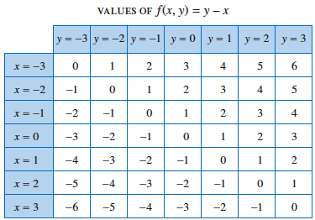
Example: Slope Field Involving Two Variables
Sketch the slope field for
y’ = y-x at the 49 grid-points (x,y) where x = -3, -2, …, 3 and y = -3, -2, …, 3 .
choosing rectangular points (x,y): given
calculating the slopes of the tangent lines to the integral curves at the grid-points: above right
drawing small segments of those tangent lines through the chosen points: right

Slide 7
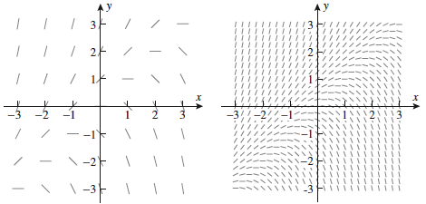
Example Continued with Integral Curves
If you have trouble envisioning the integral curves, you may want to draw tangent line segments at more grid-points, but it is a lot of work (original on left, more grid-points on right).
This should help you see the general shape of the integral curves (below).

Slide 8
General Solution
The general solution for the differential equation on the previous slides y’ = y – x is:
y = x + 1 + Ce^{x}
If we were to continue in Chapter 8 (Section 8.4) we would find out how to solve for that exactly. However, as we discussed, differential equations comprise entire courses in college. Therefore, we must stop somewhere. ☺

Slide 9
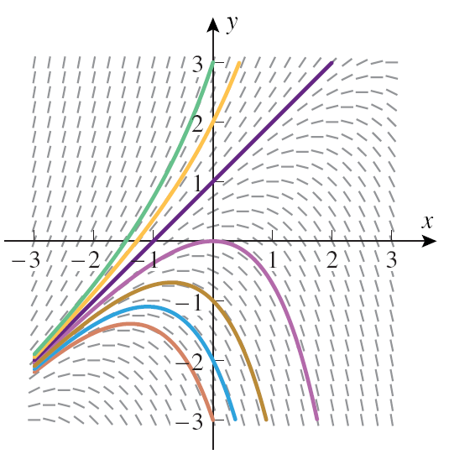
Euler’s Method
This graph helps us develop a method for approximating the solution to the initial-value problem y($x_{0}$) = $y_{0}$ numerically.
We will choose some small increment $∆x$ as we did in some sections last year and approximate y(x) at multiple values, starting at $x_{0}$which will look like:
$x_{1}$ = $x_{0}$+$∆x$
$x_{2}$ = $x_{1}$+$∆x$
$x_{3}$ = $x_{2}$+$∆x$
$x_{4}$ = $x_{3}$+$∆x$
Et cetera
NOTE: Other, better methods, often use Euler’s Method as a starting point.

Slide 10
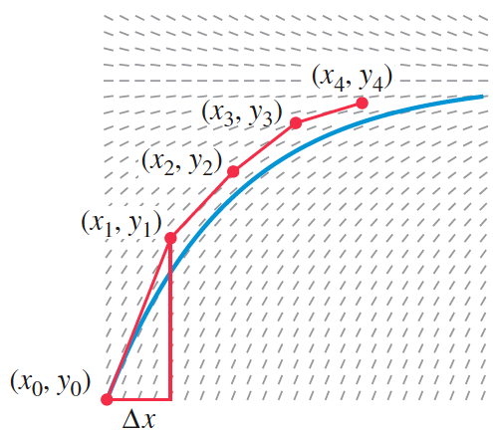
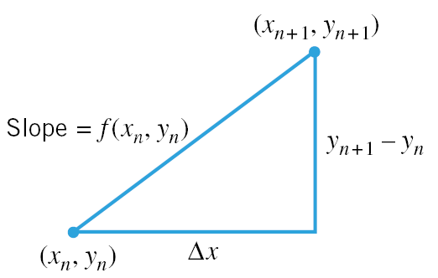
Euler’s Method con’t Using a Simpler Graph
In order to find the slope of each segment, use the given equation and the $x_{s}$ you found using the information on the previous slide and your algebra one slope formula $\frac{y_{2}−y_{1}}{x_{2}− x_{1}}$ which becomes $\frac{y_{n+1}−y_{n}}{x_{n+1}− x_{n}}$ when you are making repeated calculations.
$\frac{y_{n+1}−y_{n}}{x_{n+1}− x_{n}}$ = $\frac{y_{n+1}−y_{n}}{∆x}$ = f($x_{n}$, $y_{n}$)
$y_{n+1} −y_{n}\text{ = }$f($x_{n}$, $y_{n}$)* $∆x$ multiply both sides by $∆x$
$y_{n+1}=y_{n} \text{+}$f($x_{n}$, $y_{n}$)* $∆x$ add $y_{n}$ to both sides
This is the heart of Euler’s Method: $y_{n+1}=y_{n}\text{ + }$f($x_{n}$, $y_{n}$)($∆x)$
NOTE: it is basically point-slope form of a line with modifications

Slide 11
Formal Description of Euler’s Method

Slide 12
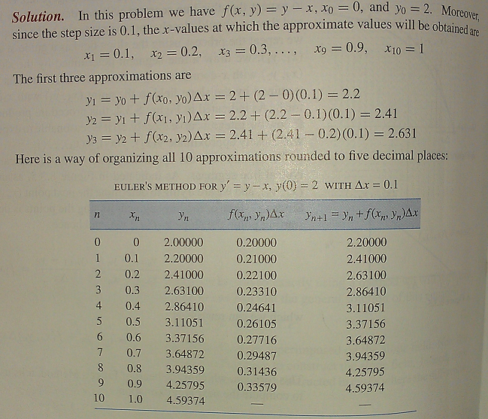
Example: Use Euler’s Method with a step size of 0.1 to make a table to approximate values of the solution of the initial-value problem y’ = y-x , y(0) = 2 over the interval [0,1].

Slide 13
Why we need Euler’s Method
If you look at the derivative in the previous example which was y’ = y-x, you will find that you cannot separate the variables like we did in section 8.2.
$\frac{dy}{dx}=y −x$
$dy=\left(y −x\right)dx$ multiply by dx
$dy=ydx−xdx$ distribute
$dy−ydx=xdx$ subtract ydx
That is why we made the table in the previous example.

Slide 14
Accuracy of Euler’s Method
When determining how far the Euler approximation is compared to the exact solution, it is helpful to remember that the error is proportional to the step size.
Therefore, the smaller the step size used, the greater the accuracy in the Euler approximation.
Also, the absolute error tends to increase as x moves away from x₀.

Slide 15
Absolute Error and Percentage Error
Absolute Error = $\left|exact value −approximation\right|$
Percentage Error = $\frac{\left|exact value −approximation\right|}{\left|exact value \right|}$ * 100%

Slide 16
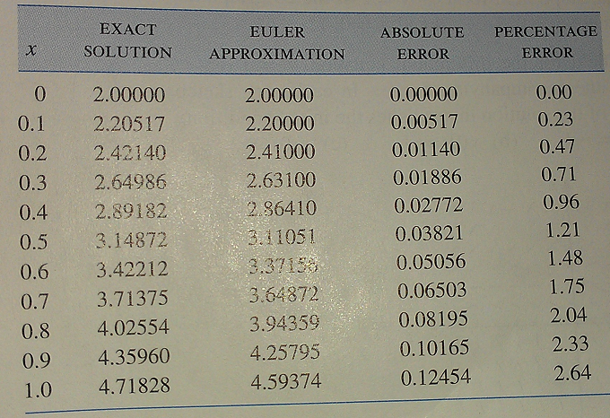
Euler Approximation Error Example
The exact solution to the initial-value problem in Example 1 is y = x + 1 + e^{x}.
If you are not sure why, look back at the “General Solution” slide and substitute the initial condition y(0)=2.
Resulting table of
solutions and errors:

Slide 17
The End
The following slides are for use in class to go over some of the exercises.

Slide 18
Exercise #3

Slide 19
Exercise #3 All in One Graph

Slide 20
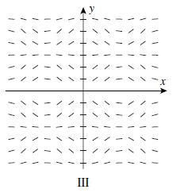
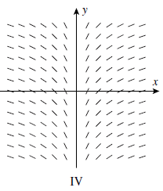
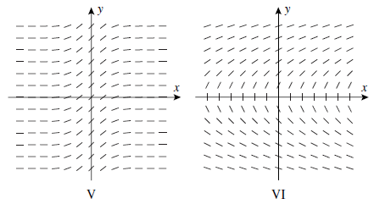
Exercise #6

Slide 21
Exercise #6 Matching

Slide 22
Exercise #17

Slide 23
Solution to #17b

Slide 24
My mom’s birthday

